Slide 1
UNIT-V FLIPFLOPS
There are two types of storage elements 1. Latches 2. Flipflops
Storage elements that operate with signal level are referred as latch and those controlled by a clock transition are referred as flipflops.

Slide 2
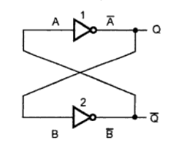
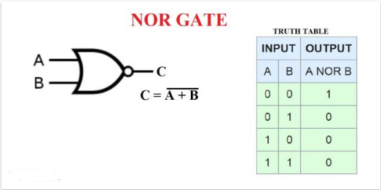

Slide 3
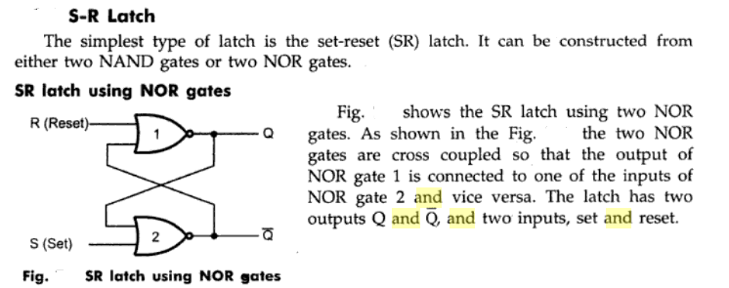

Slide 4
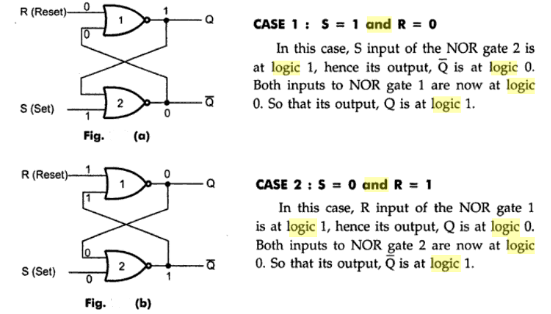

Slide 5
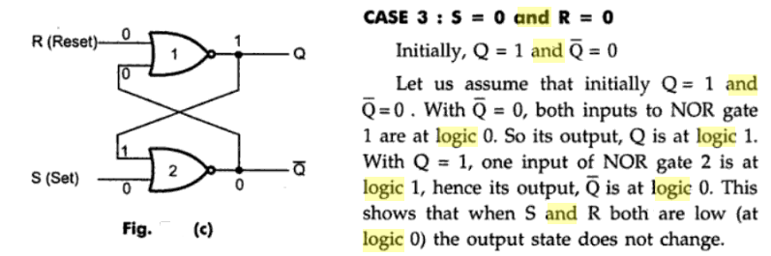

Slide 6
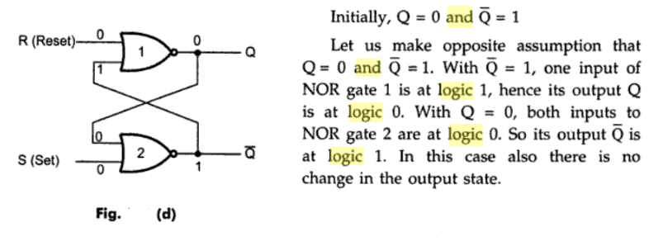

Slide 7
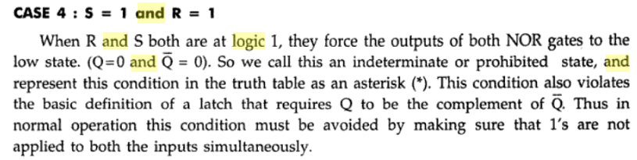

Slide 8
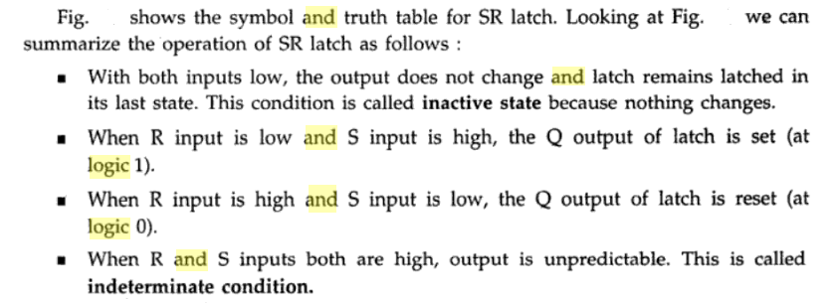

Slide 9
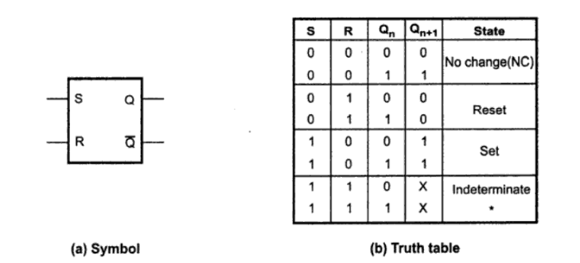

Slide 10

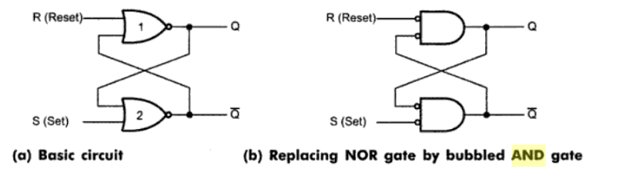

Slide 11
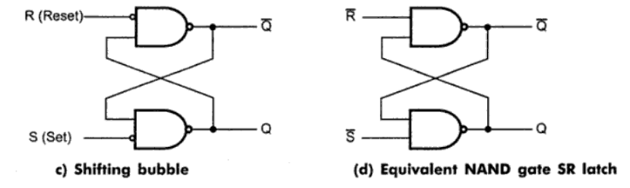

Slide 12
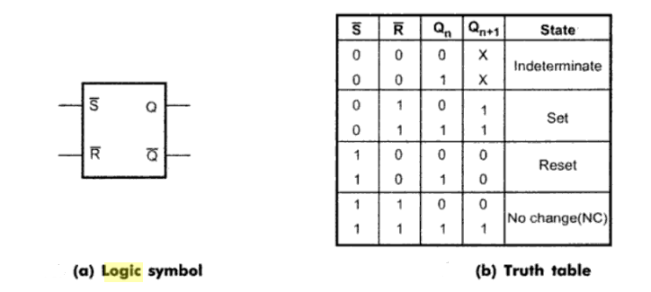

Slide 13
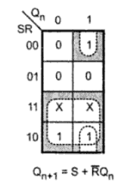

Slide 14
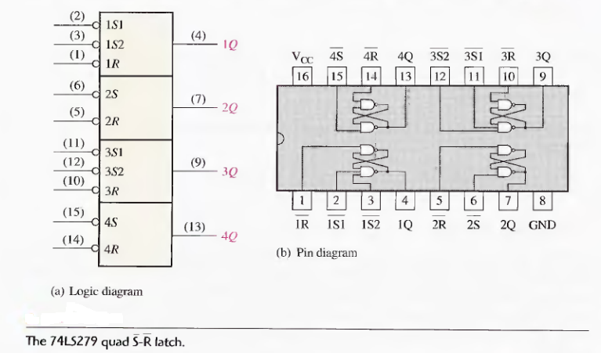

Slide 15

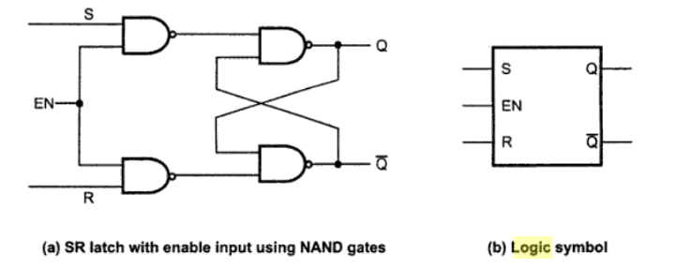

Slide 16
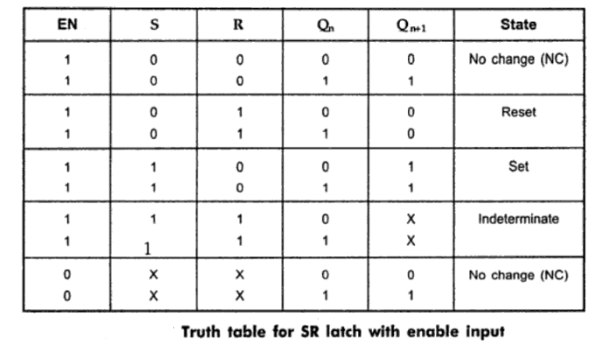

Slide 17

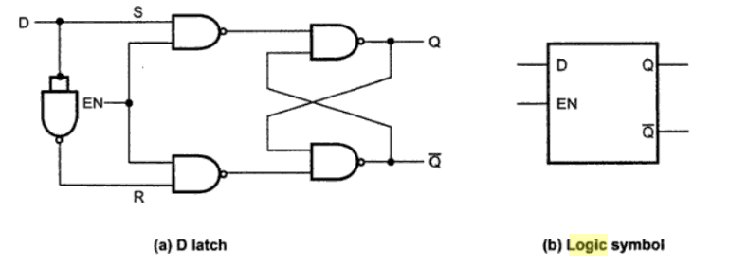

Slide 18
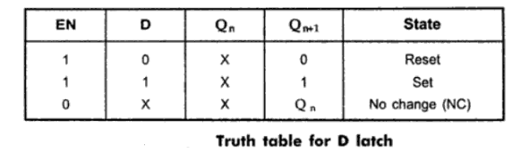

Slide 19
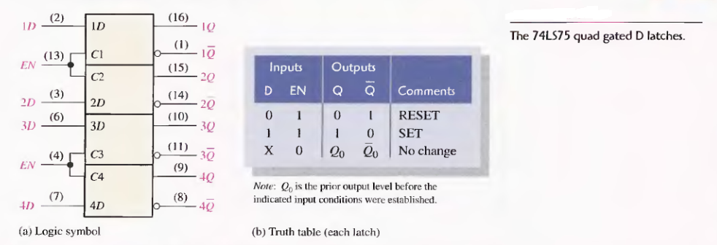

Slide 20
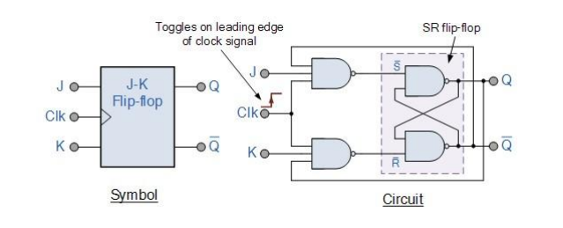
JK Flip flop

Slide 21
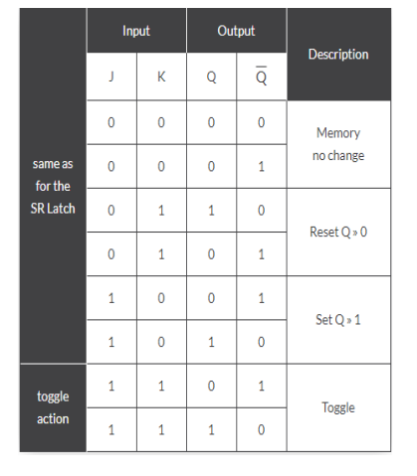

Slide 22
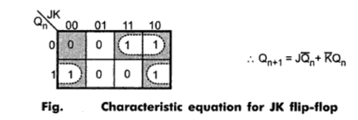

Slide 23
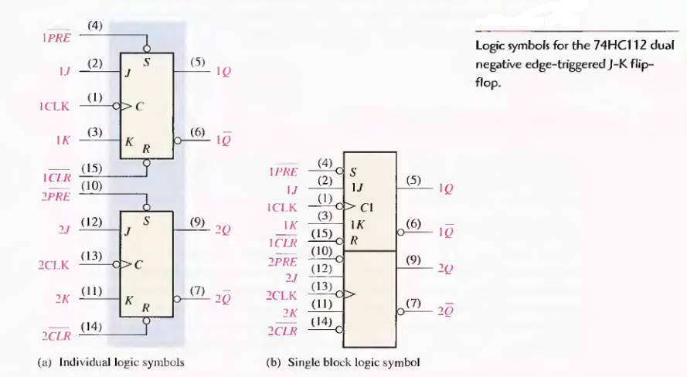

Slide 24

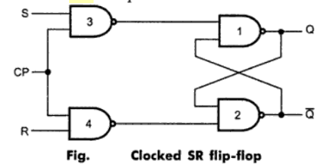

Slide 25
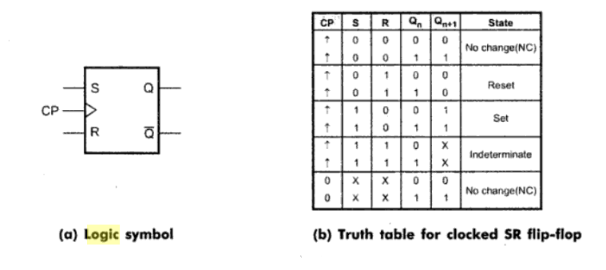

Slide 26

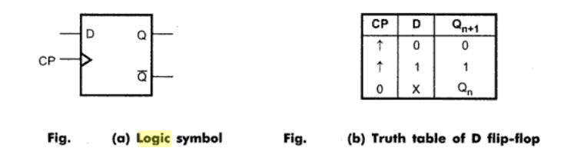

Slide 27
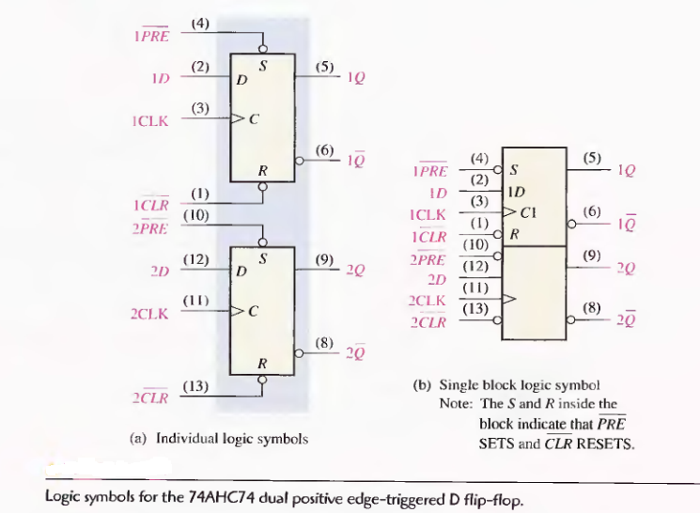

Slide 28
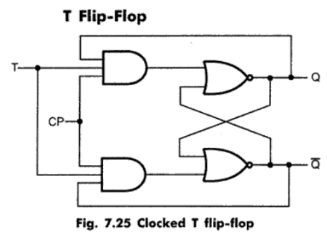

Slide 29
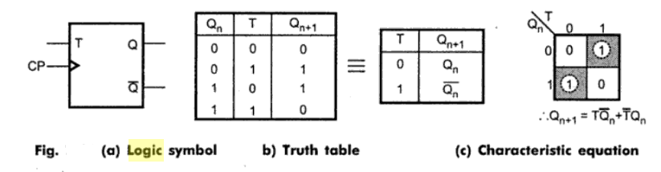

Slide 30
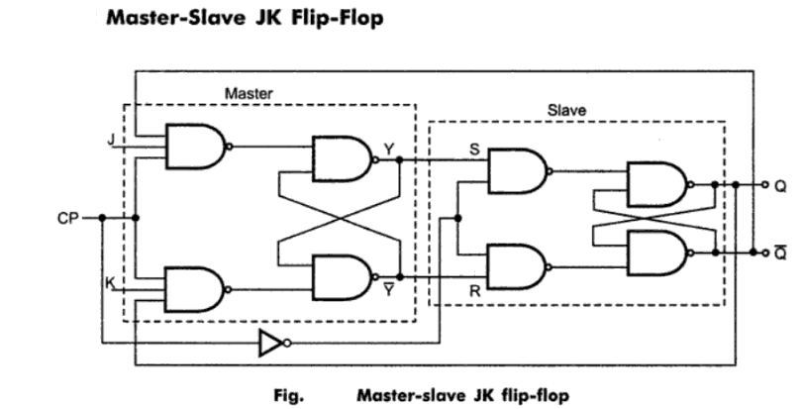

Slide 31
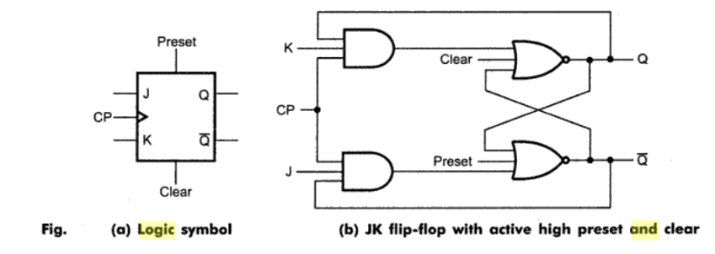

Slide 32
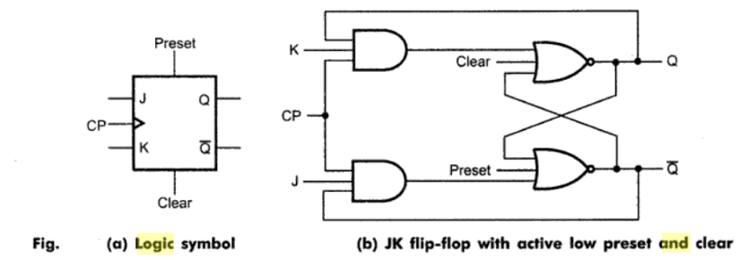

Slide 33
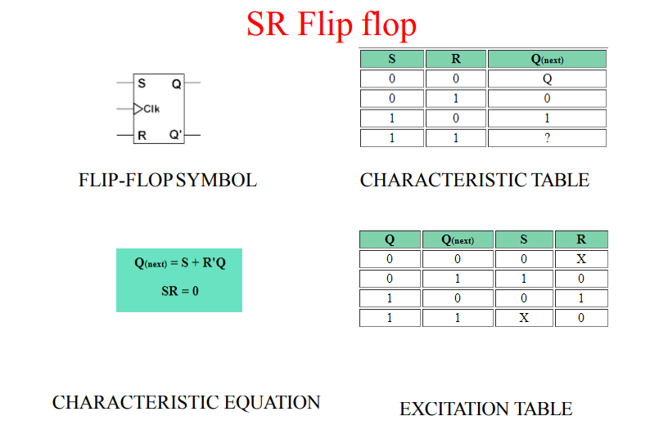
FLIPFLOPS:EXCITATION FUNCTIONS

Slide 35
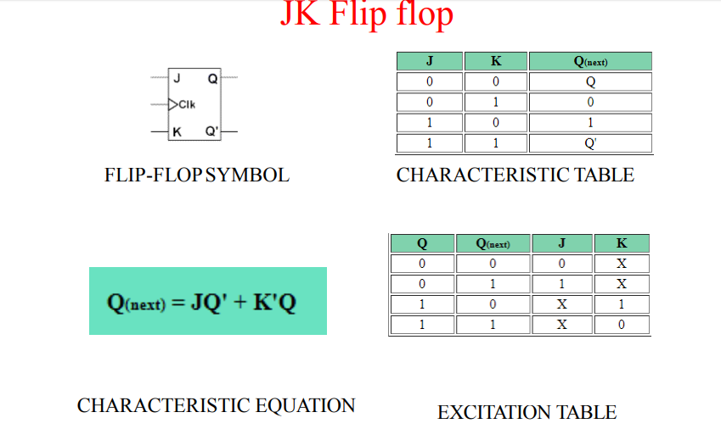

Slide 37
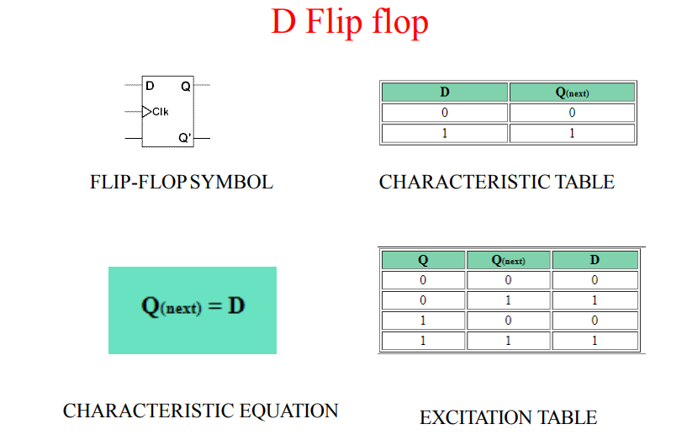

Slide 38
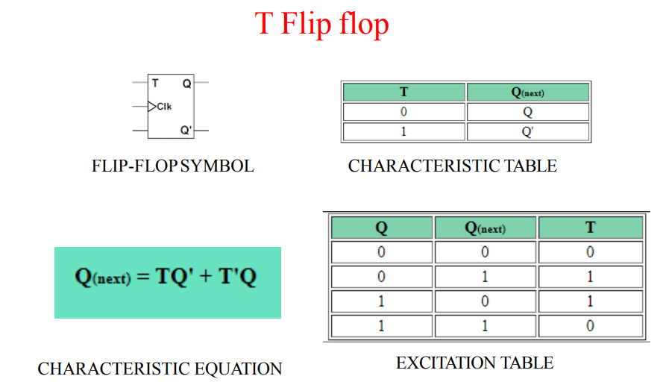

Slide 39
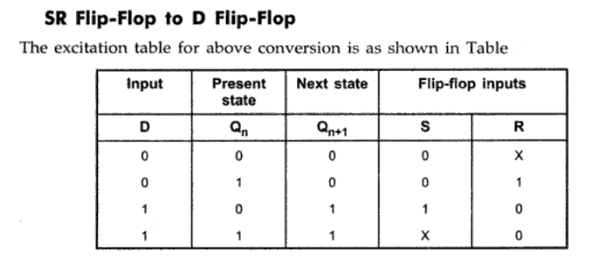
Flipflop coversions

Slide 40
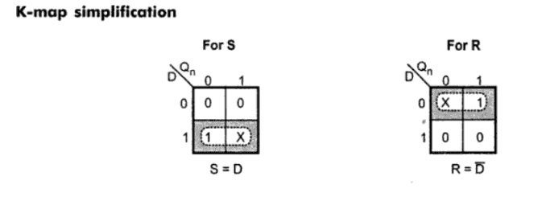
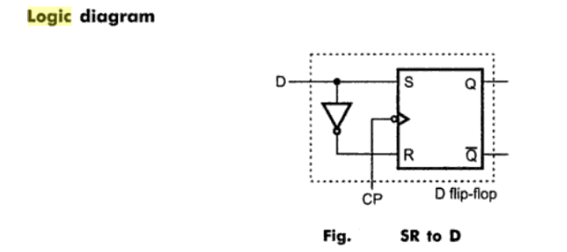

Slide 41
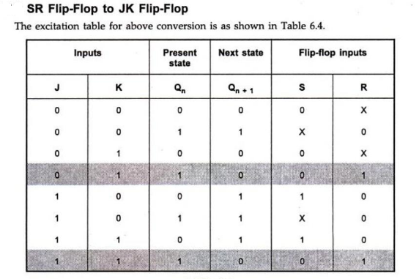

Slide 42
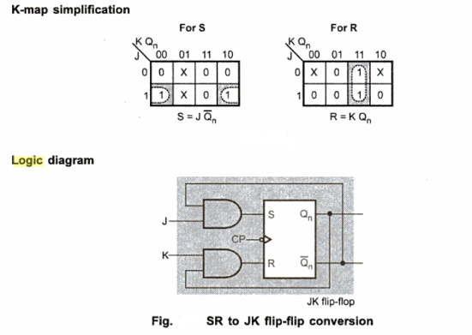

Slide 43
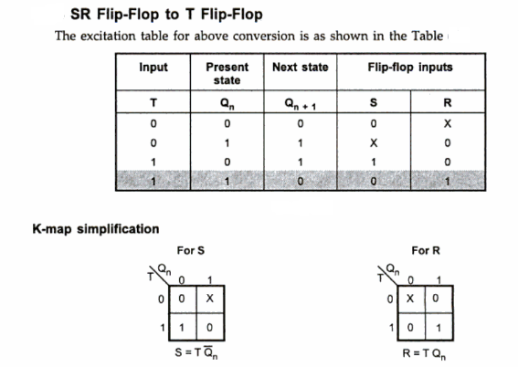

Slide 44
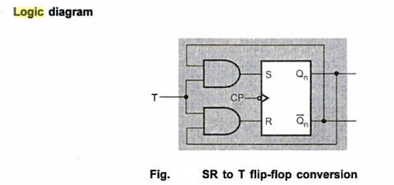

Slide 45
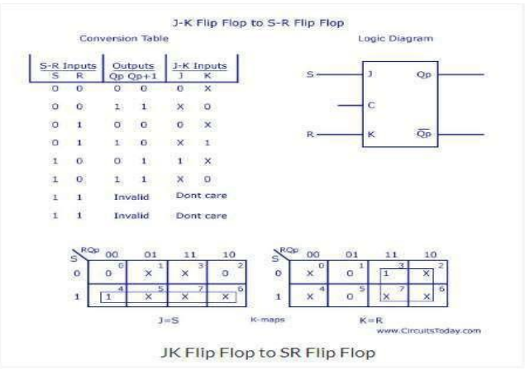
CONVERSION OF JK FLIP FLOP TO SR FLIPFLOP

Slide 46
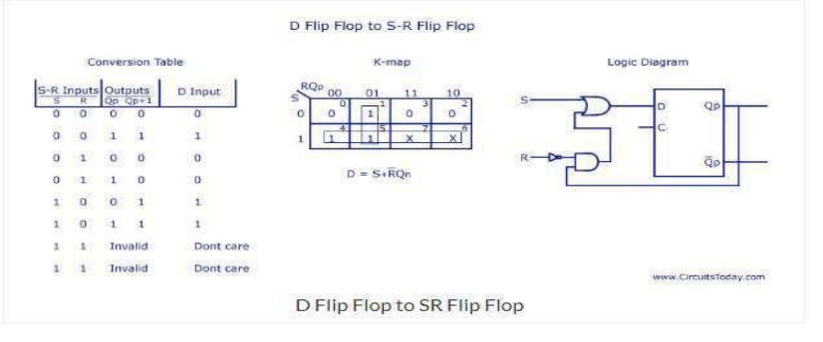
CONVERSION OF D FLIP FLOP TO SR FLIPFLOP

Slide 47
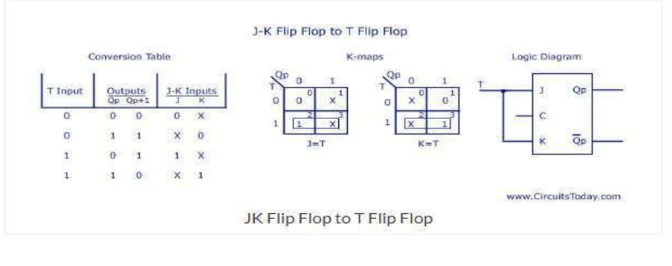
CONVERSION OF JK FLIPFLOPTO T FLIPFLOP

Slide 48
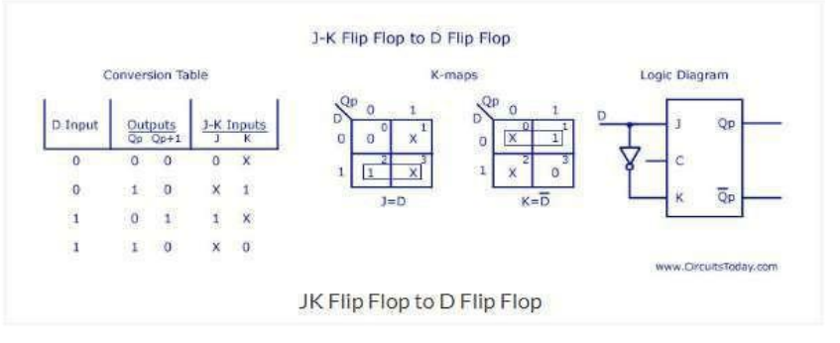
CONVERSION OF JK FLIP FLOP TO D FLIPFLOP

Slide 49
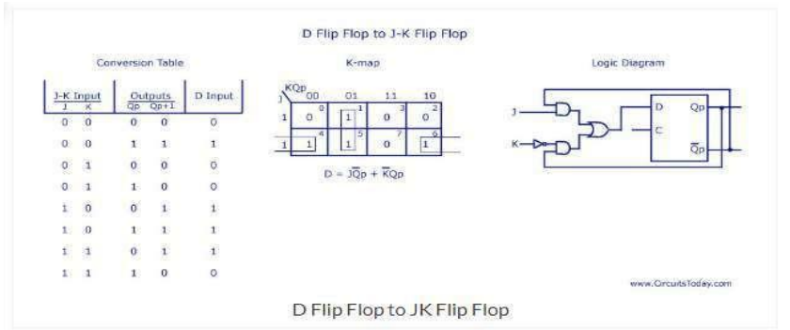
CONVERSION OF D FLIP FLOP TO JK FLIPFLOP

Slide 50
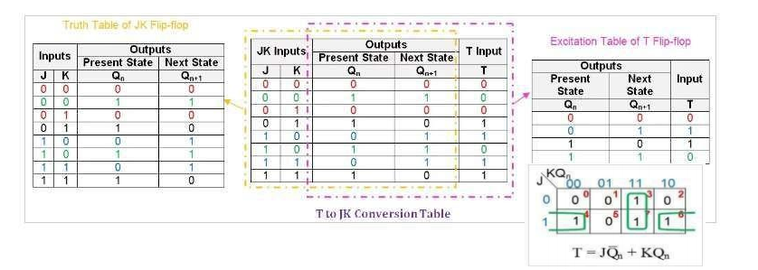
CONVERSION OFT FLIPFLOPTO JK FLIPFLOP

Slide 51

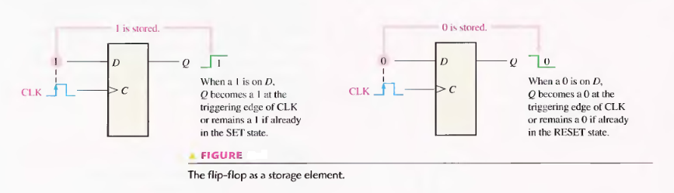

Slide 52


Slide 53


Slide 54


Slide 55


Slide 56


Slide 57


Slide 58


Slide 59


Slide 60


Slide 61


Slide 62


Slide 63


Slide 64


Slide 65


Slide 66


Slide 67



Slide 68


Slide 69


Slide 70


Slide 71



Slide 72


Slide 73


Slide 74



Slide 75


Slide 76




Slide 77


Slide 78



Slide 79


Slide 80


